Slide 1
I2C Touch driver for RockChip
2010/09/03
Chaoban

Slide 2
RK2808 resource
Kernel
  rk2808_opensource_trunk
  Linux 2.6.25
Tool chain
  arm-eabi-4.2.1

Slide 3
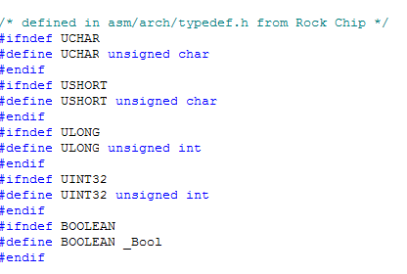
Type define
Rock chip have some date type self.
include\asm-arm\arch-rockchip
sisTP\ParserInput\sistype.h

Slide 4
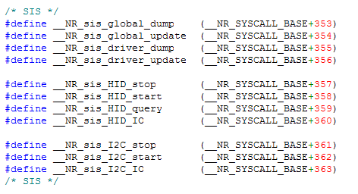
System call
Interface of system calls for ARM.
\arch\arm\kernel\calls.S
\include\linux\syscalls.h
\include\asm-arm\unistd.h

Slide 5
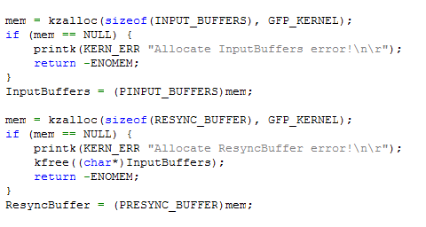
Custom driver
\touchscreen\sisTP\oemsrv.c
allocate input and resync buffers.

Slide 6
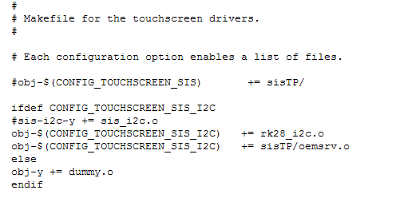
Custom driver
Makefile
  For custom module.
  \touchscreen\Makefile

Slide 7
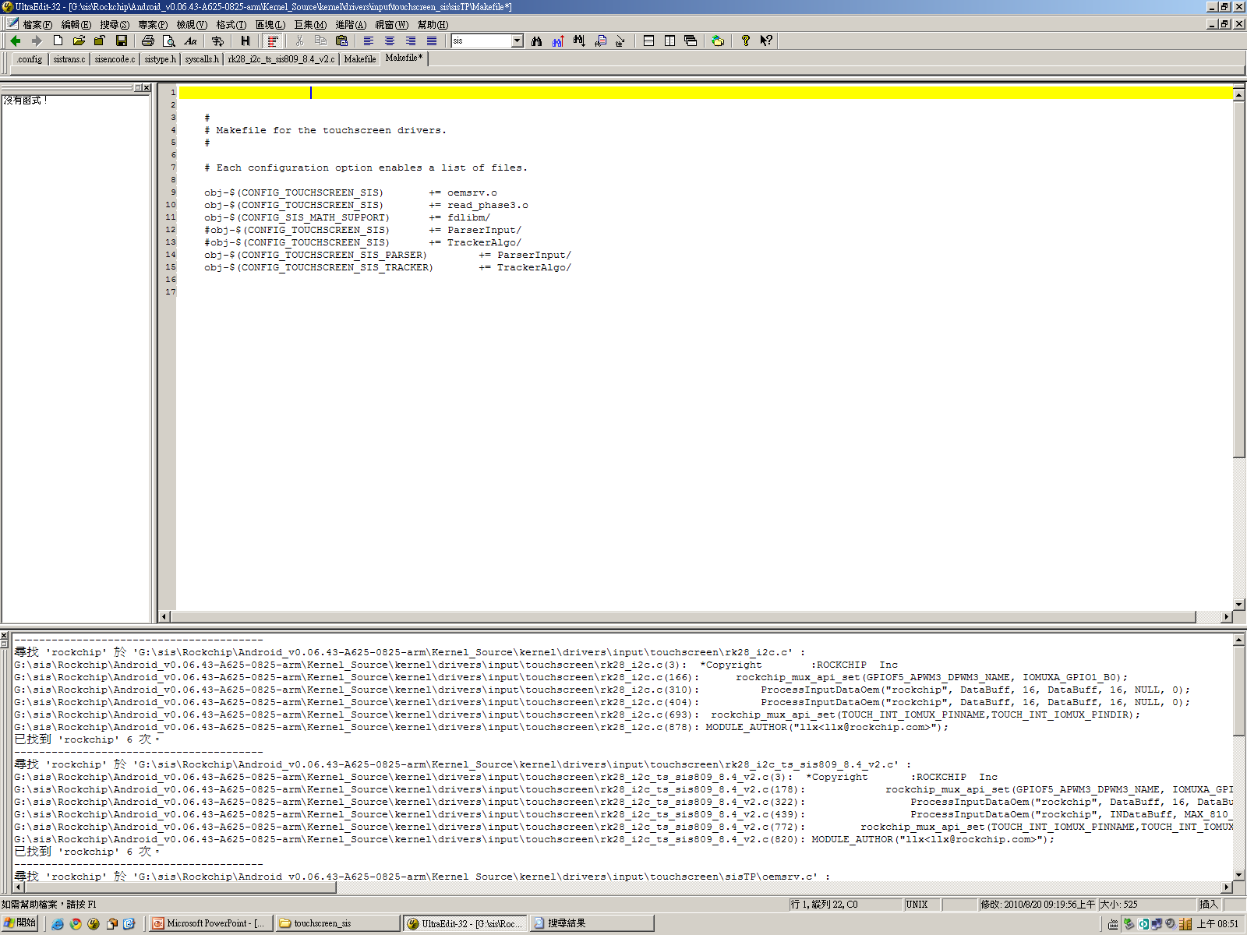
Custom driver
Makefile
  For In-kernel driver.
  \touchscreen\sisTP\Makefile

Slide 8
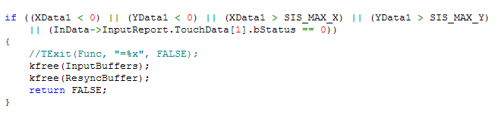
Custom driver
Patch incorrect points by sensing issues.

